Slide 1

Image Scraping and Classification Project
Submitted By-
AKSHAY DINESH SHAH

Slide 2
ACKNOWLEDGMENT
I express my sincere gratitude to Flip Robo Technologies for giving me the opportunity to work on this project on Malignant Comment Classifier using machine learning algorithms and Deep Learning libraries. I acknowledge google, medium.com, and analytics vidya for providing me with invaluable knowledge and insights into what image classification and the role of Deep Learning processing tools and techniques in identifying them and in helping build models to classify input images.

Slide 3
Introduction
Images are one of the major sources of data in the field of data science. This field is making appropriate use of information that can be gathered through images by examining its features and details. We are trying to give you an exposure of how an end-to-end project is developed in this field.
The idea behind this project is to build a deep learning-based Image Classification model on images that will be scraped from e-commerce portal. This is done to make the model more and more robust.
The Project consists of two phases:
Data Collection Phase
Model Building Phase

Slide 4
The Dataset
The training dataset contains 400 images scarped from amazon.com of saree, jeans and trousers.
The test dataset contains 72 images.
We have scraped Images from amazon.com using Selenium

Slide 5
Data Collection Phase:
We must scrape images from e-commerce portal, Amazon.com. The clothing categories used for scraping will be:
Sarees (women)
Trousers (men)
Jeans (men)
First, we have scraped link to those images using Selenium framework and then created directories to download and save scraped images. The categories are defined as Jeans: 0, Sarees: 1, Trousers: 2.
We have scraped 431 images for each category i.e., total of 1239 images is collected. Then I have created a directory to download images.

Slide 6
Visualization of Images

Slide 7
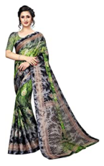
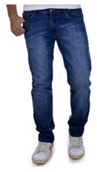
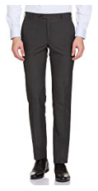
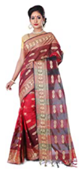
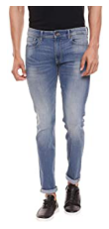
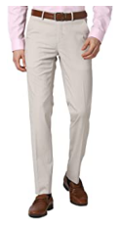
Saree
Jeans
Trouser

Slide 8
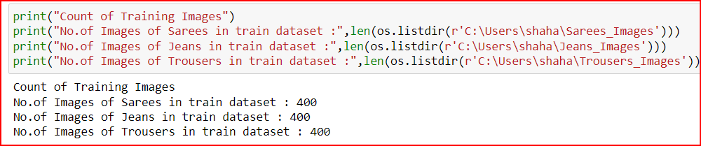
Count of images for training

Slide 9
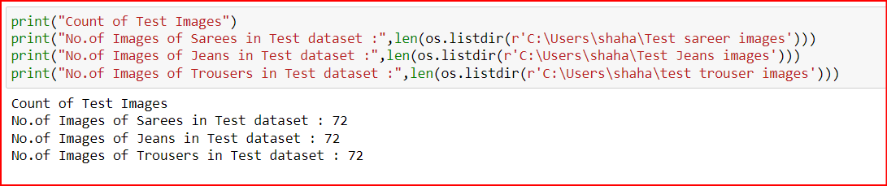
Count of images for test data

Slide 10
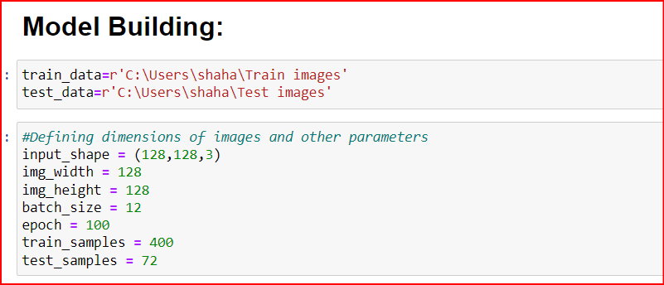
Model Building Phase:
After the data collection and preparation is done, I have built an image classification model that will classify between these 3 categories mentioned as:-
Saree as ‘0’,
Jeans as ‘1’,
Trouser as ‘2’.
First, we will be defining dimensions of images and other parameters too. Then for data augmentation we defined training and testing set.

Slide 11
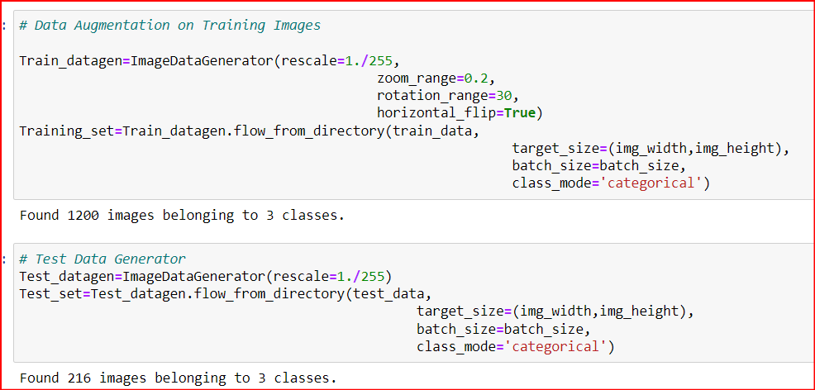
Data Augmentation

Slide 12
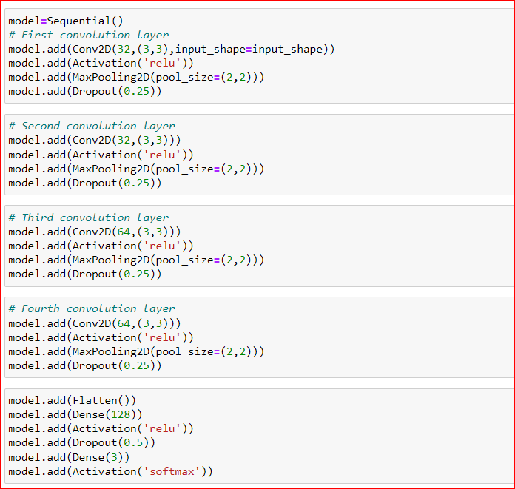
Next, we have created a model using Convolution Neural Network

Slide 13
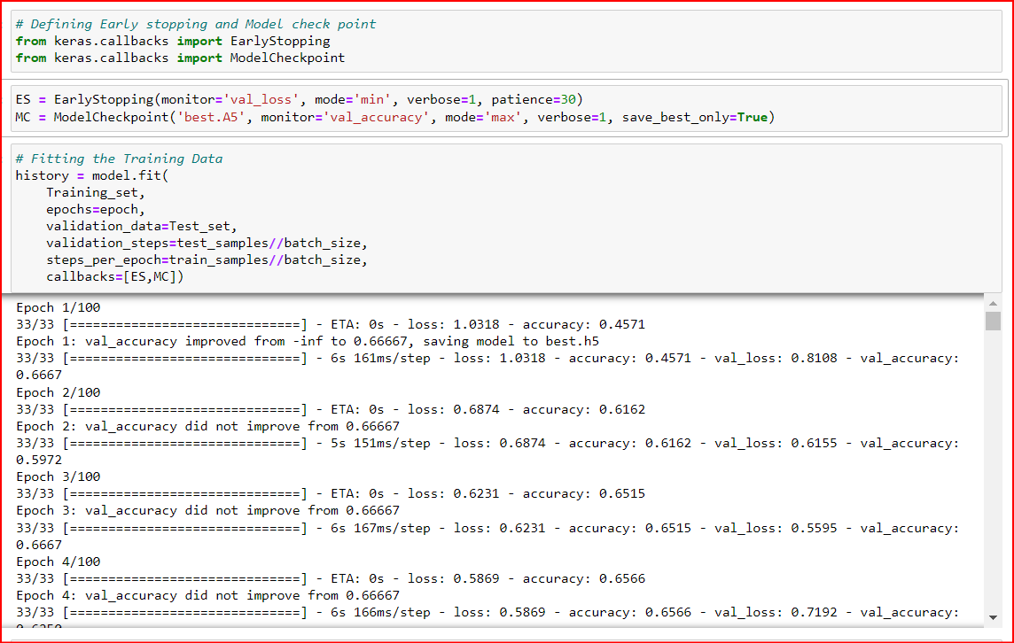
Now we will define early stop criteria and model check point further saving the model as “best_model.h5”.

Slide 14
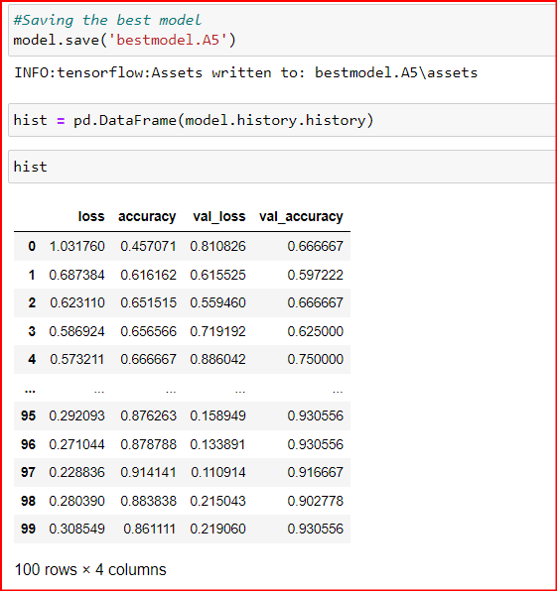
Predictions

Slide 15
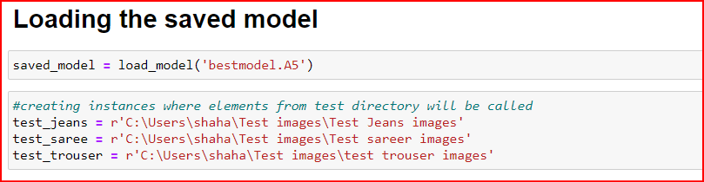
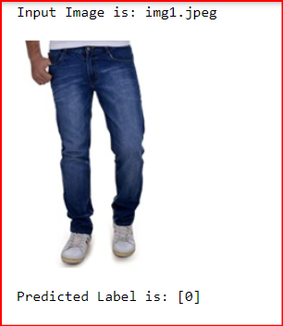
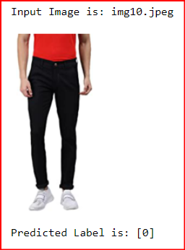

Slide 16
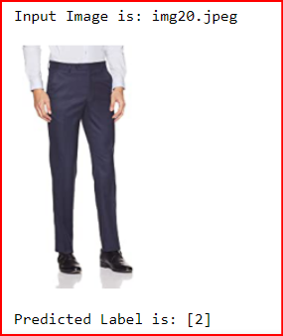
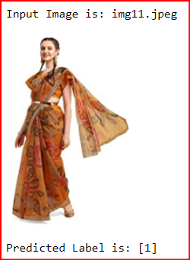
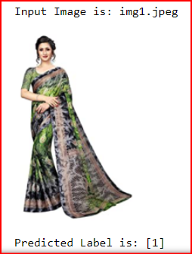
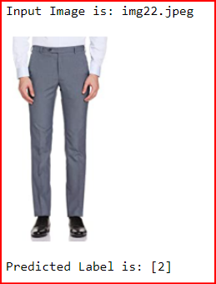

Slide 17
Conclusion
In conclusion, this project is about image classification by using deep learning via framework TensorFlow. The roles of epochs in
CNN was able to control accuracy and prevent any problems such as overfitting. Thus, we were able to classify the three categories of images with an accuracy of 90.91%
In this project I was able to learn about Deep Neural Networks and Convolution Neural Network. I also learned techniques to scrap and download images in the specified directory using code.

Slide 18
Thank You

